Slide 1
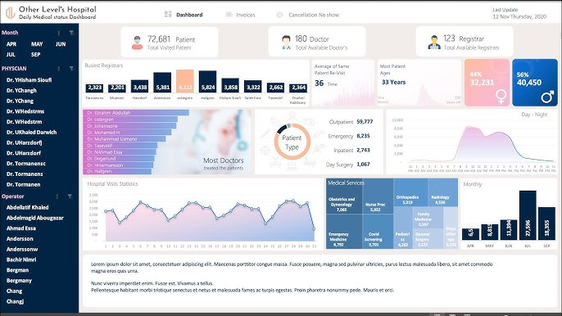



Healthcare Data Analysis
Comprehensive Healthcare Dataset Analysis Project
Objectives
Tools Used
Target Audience
Understanding healthcare patterns
Analyzing costs
Extracting actionable insights
Python
SQL
Streamlit
Power BI
Healthcare data analysts
Hospital managers
Academic research teams
Healthcare policy makers

Slide 2





Data Overview
55000+
Patient Records
Demographics
Medical Data
Age, Gender, Blood Type
Medical Condition, Test Results
Admission Data
Financial Data
Admission Type, Length of Stay
Cost, Insurance Providers
Data is processed and normalized (Normalized, Encoded, Scaled) to ensure analysis quality

Slide 3


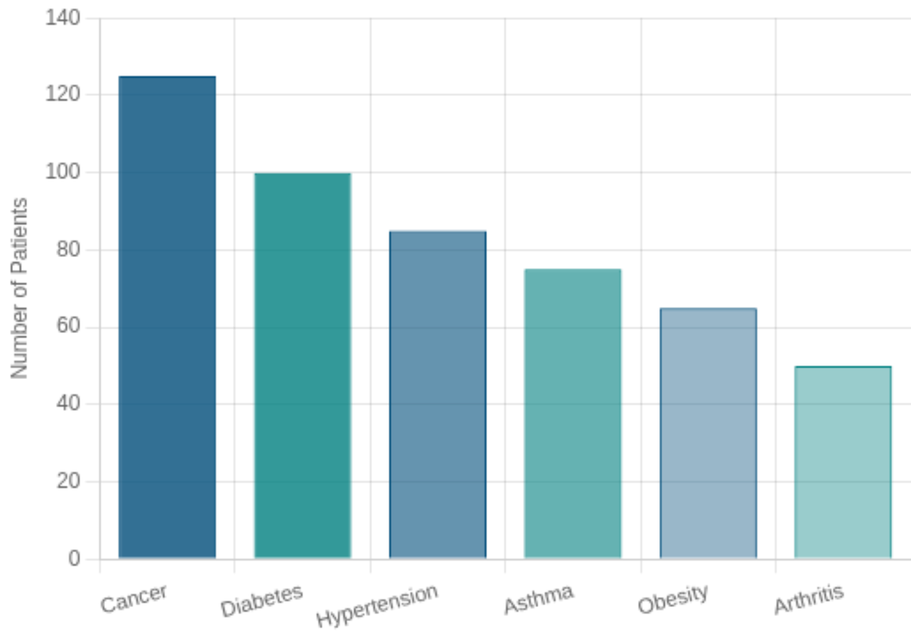
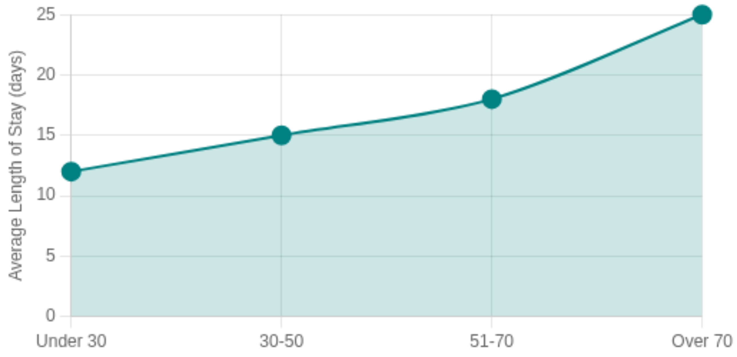

Basic Visualizations (from SQL)
Distribution of Medical Conditions
Relationship Between Age and Length of Stay
SELECT medical_condition, COUNT(*) AS patient_count FROM healthcare_dataset GROUP BY medical_condition ORDER BY patient_count DESC
SELECT CASE WHEN age < 30 THEN 'Under 30' WHEN age BETWEEN 30 AND 50 THEN '30-50' WHEN age BETWEEN 51 AND 70 THEN '51-70' ELSE 'Over 70' END AS age_group, AVG(length_of_stay) AS avg_stay FROM healthcare_dataset GROUP BY age_group ORDER BY age_group
Cancer is most common (25% of cases), followed by Diabetes (20% of cases).
Patients over 70 years old stay longer in hospital (average 25 days).

Slide 4


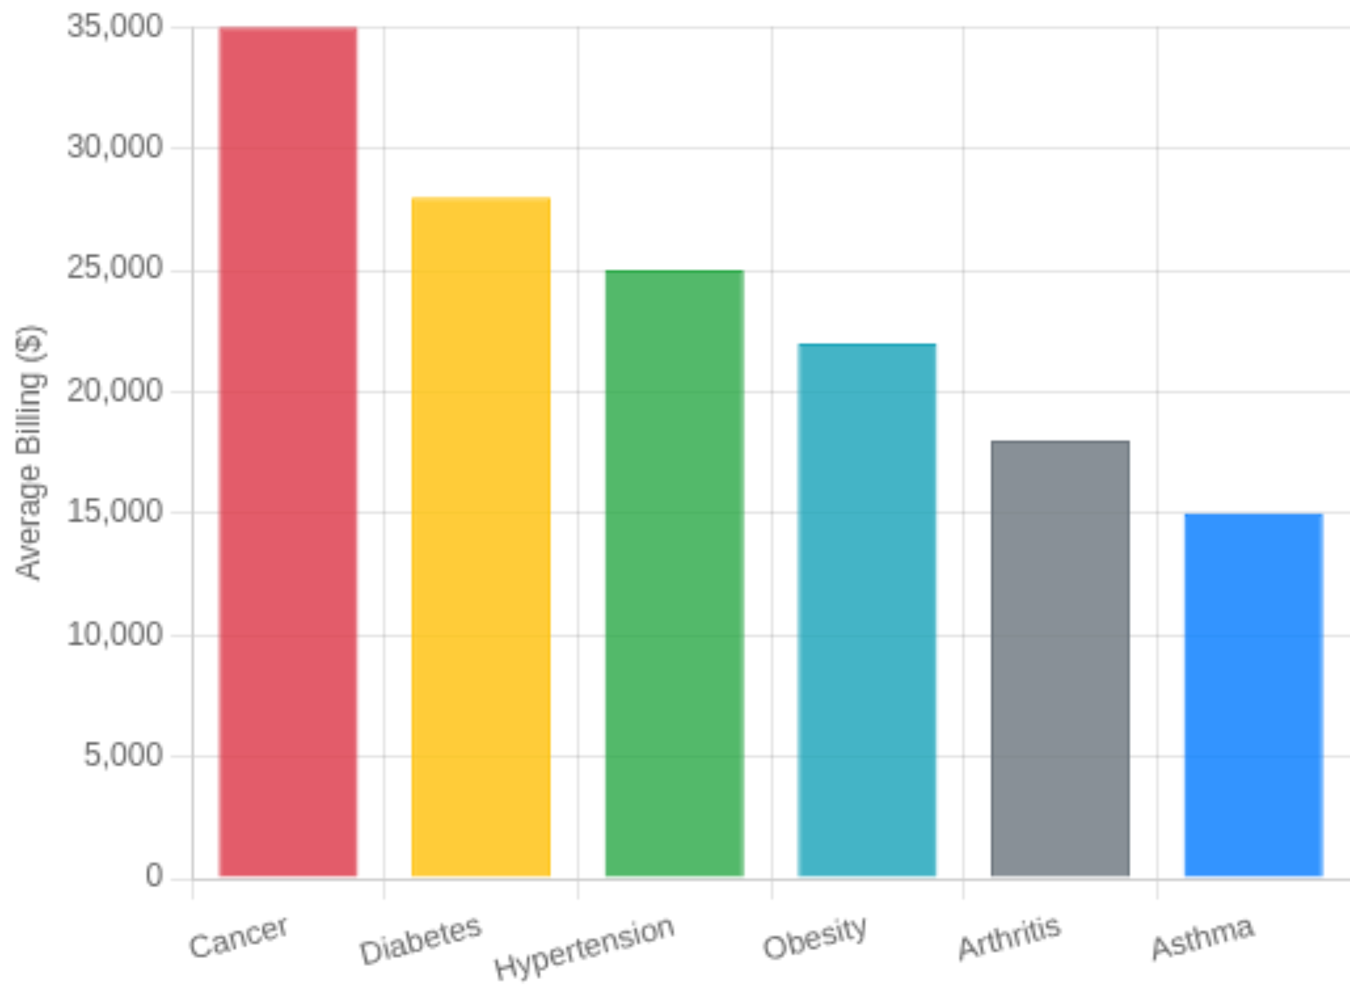
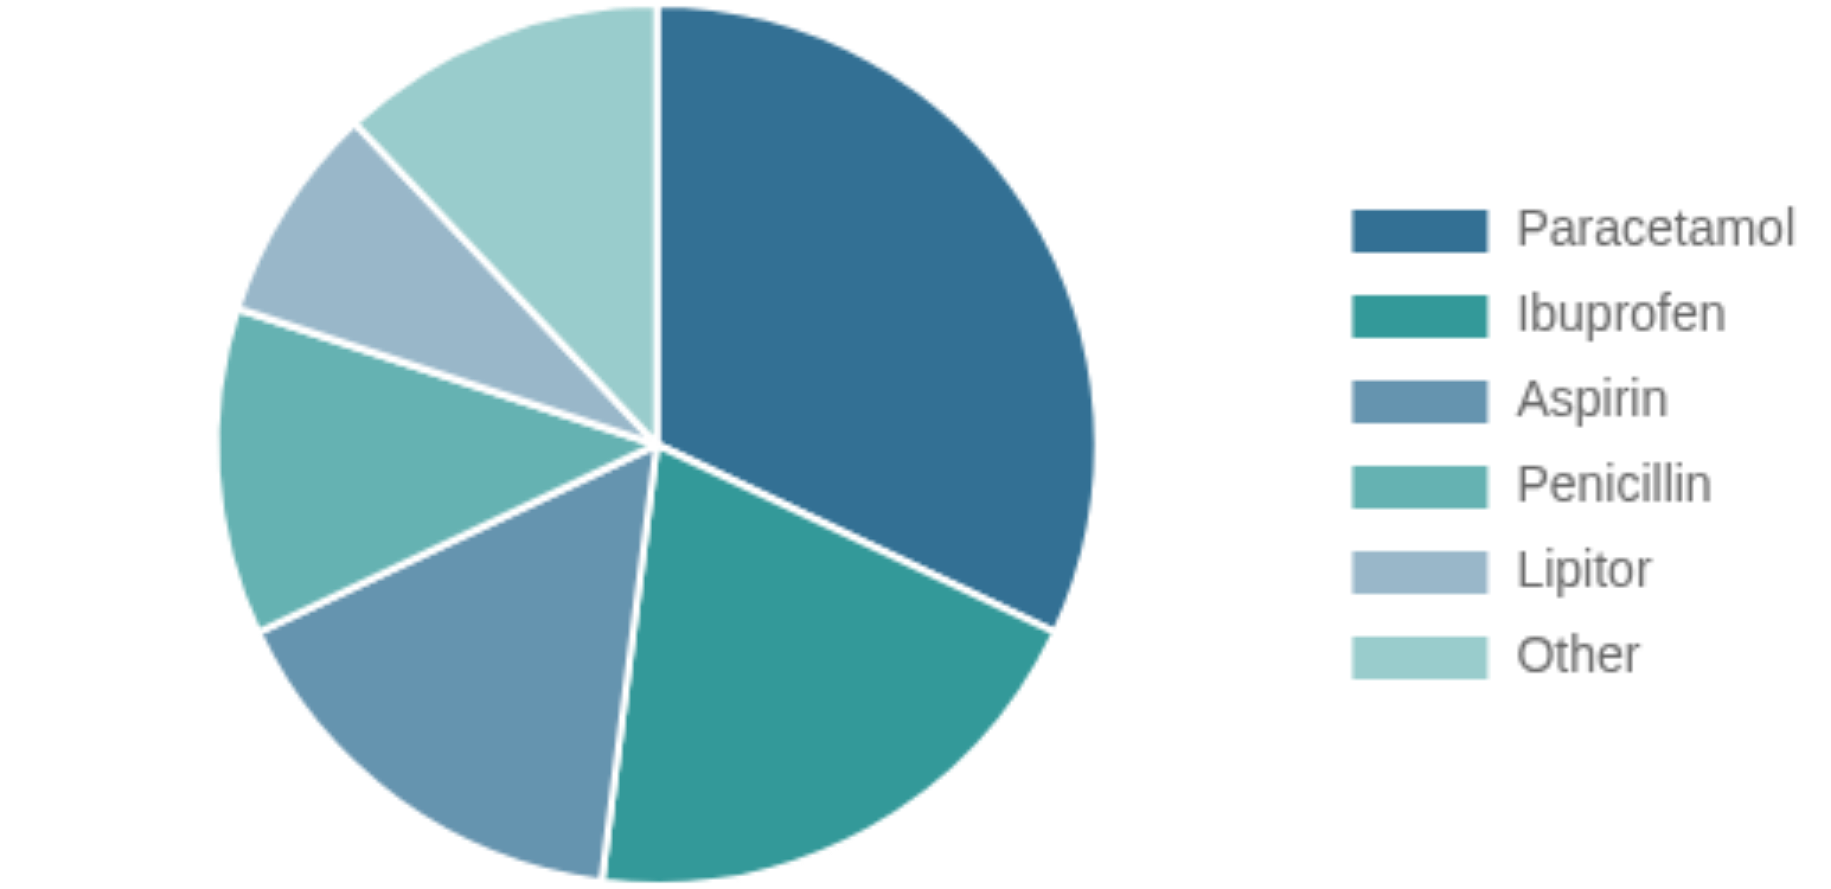


Cost and Treatment Analysis
Average Billing by Medical Condition
Most Common Medications for Each Condition
SELECT medical_condition, AVG(billing_amount) AS avg_billing FROM healthcare_dataset GROUP BY medical_condition ORDER BY avg_billing DESC
SELECT medical_condition, medication, COUNT(*) AS usage_count FROM healthcare_dataset GROUP BY medical_condition, medication ORDER BY medical_condition, usage_count DESC
Paracetamol is most used in most conditions
Paracetamol - 40% of prescriptions
Ibuprofen - 25% of prescriptions
Highest billing: Cancer (avg $35,000)
Lowest billing: Asthma (avg $15,000)
Aspirin - 20% of prescriptions
Penicillin - 15% of prescriptions

Slide 5


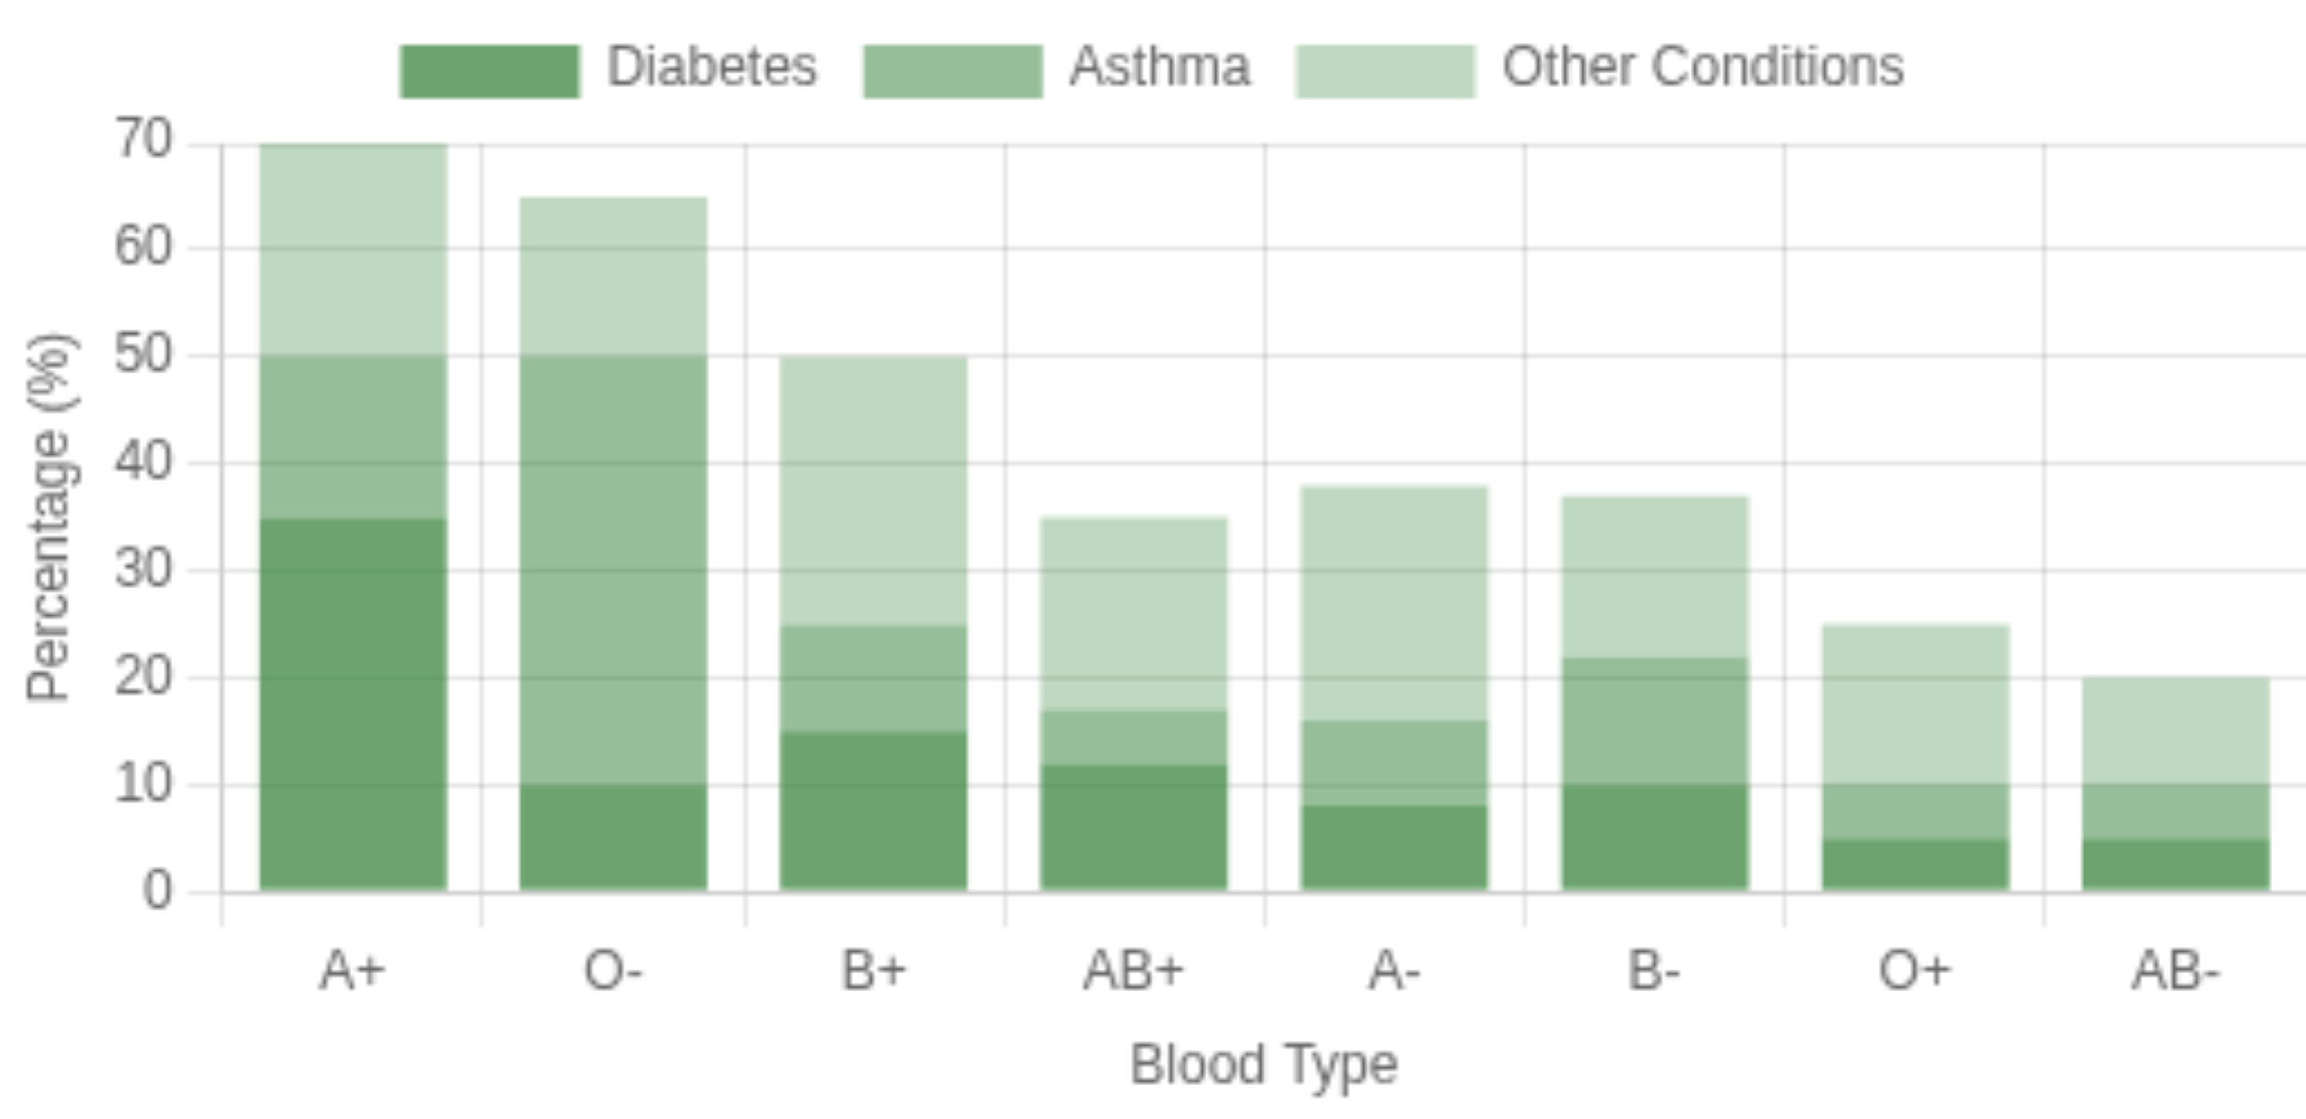
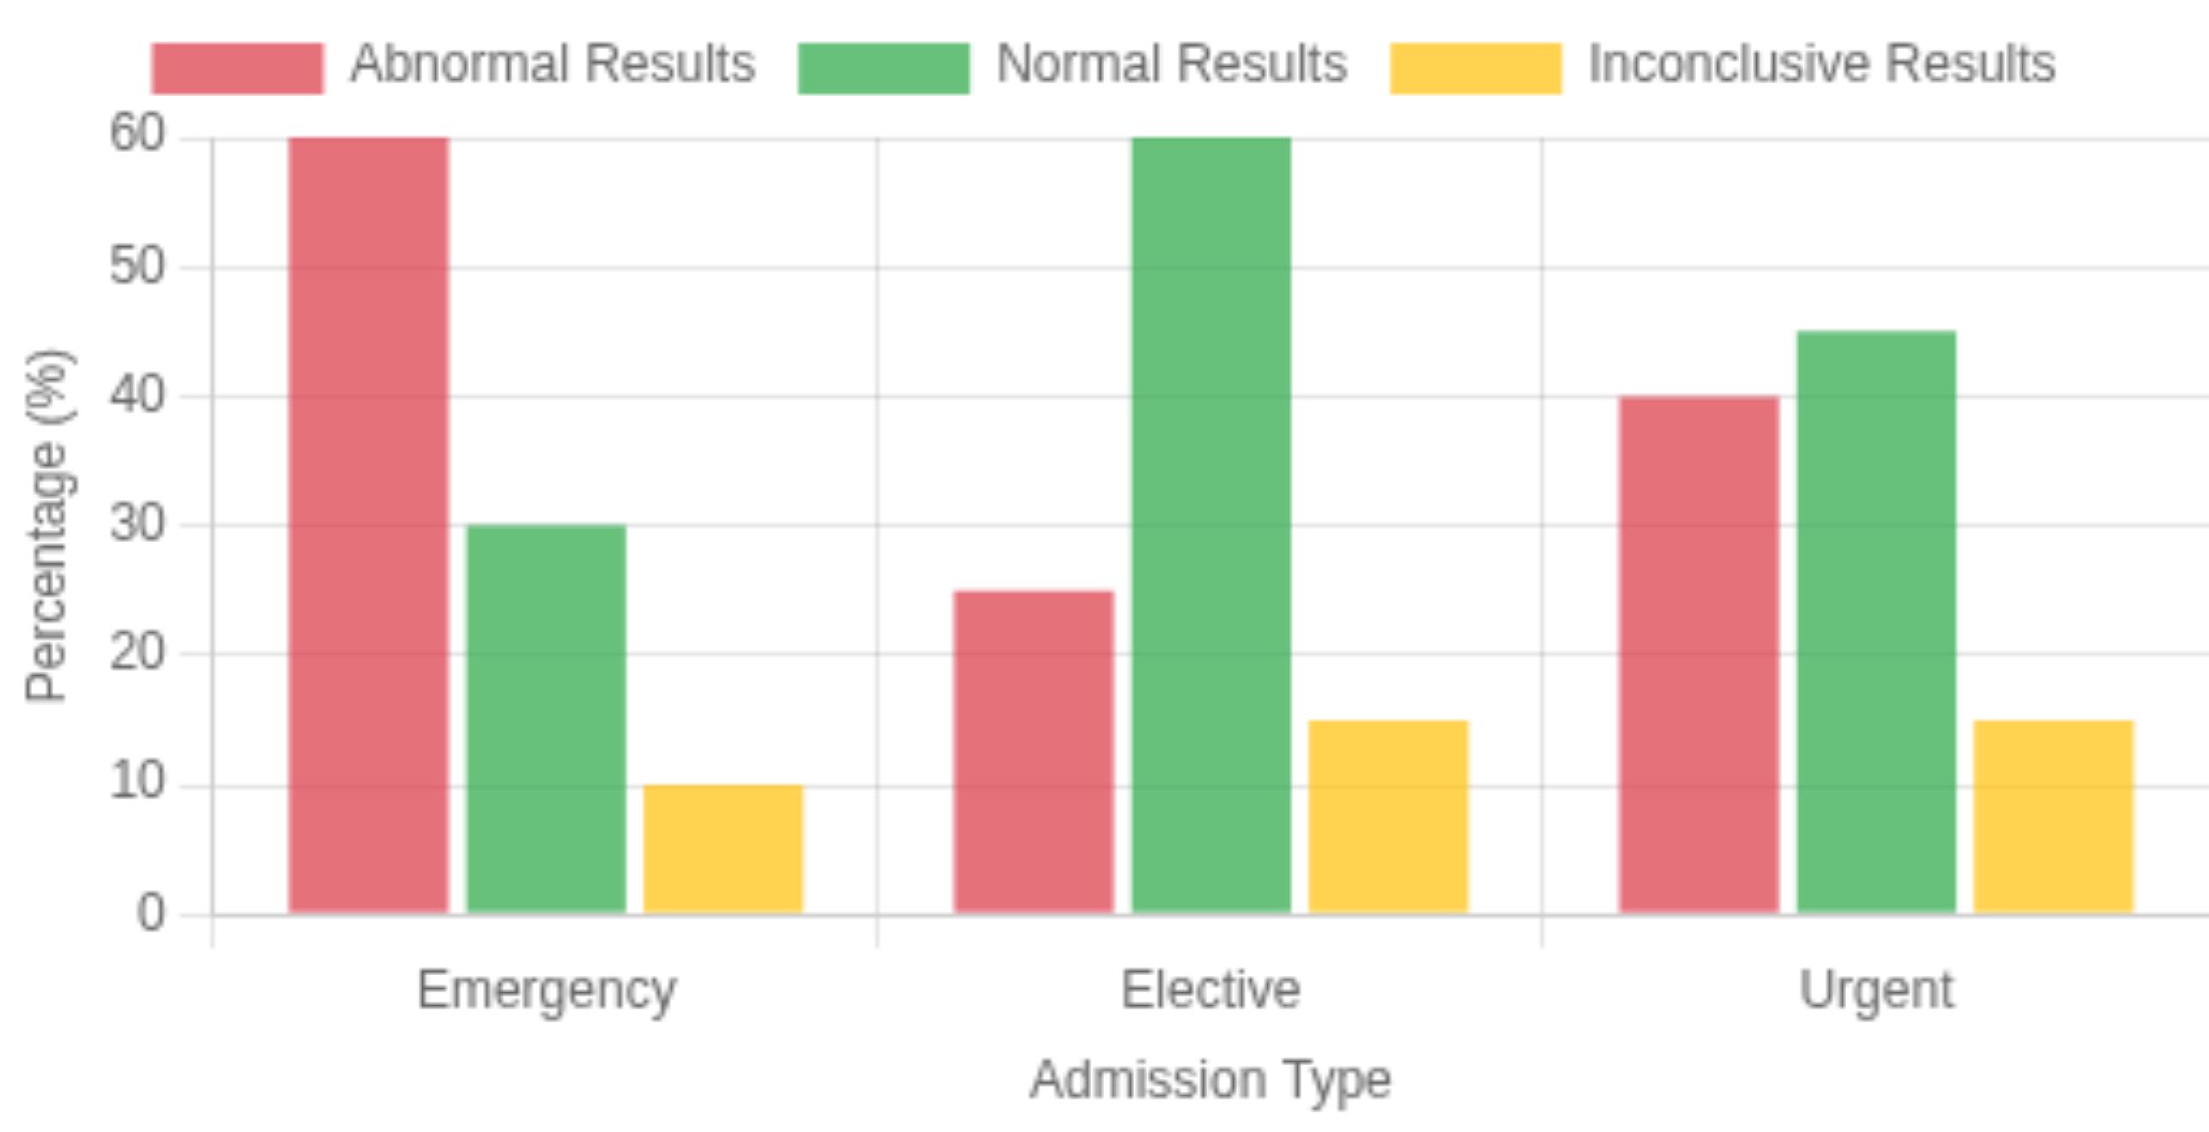


Advanced Analysis
Relationship Between Blood Type and Medical Condition
Relationship Between Admission Type and Test Results
SELECT blood_type, medical_condition, COUNT(*) AS count FROM healthcare_dataset GROUP BY blood_type, medical_condition ORDER BY count DESC
SELECT admission_type, test_results, COUNT(*) AS count FROM healthcare_dataset GROUP BY admission_type, test_results ORDER BY admission_type, count DESC
Blood type A+ often associated with Diabetes
Blood type O- associated with Asthma
Emergency cases have higher rate of abnormal results
Blood type A+ appears in 35% of Diabetes cases
60% of Emergency cases have abnormal results
Blood type O- appears in 40% of Asthma cases
Only 25% of Elective cases have abnormal results

Slide 6

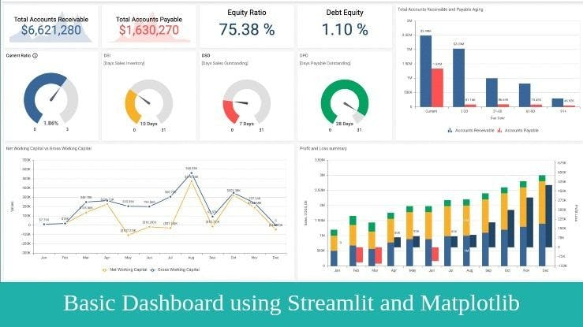










Interactive Visualization with Streamlit
Interactive Dashboard
Data Filtering
Filter data by:
Medical Condition
Age
Admission Type
Insurance Provider
Visualization Capabilities
View:
Dynamic Charts
Summary Tables
Heatmaps
Technical Features
• Real-time data updates
• User-friendly interface
• Fast response time
• Database integration

Slide 7
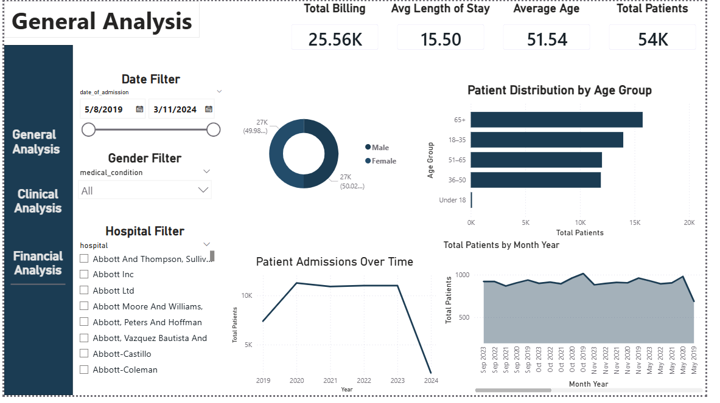
Power BI Dashboard
General Analysis
Comprehensive Healthcare Dataset Analysis with Interactive Dashboards

Slide 8
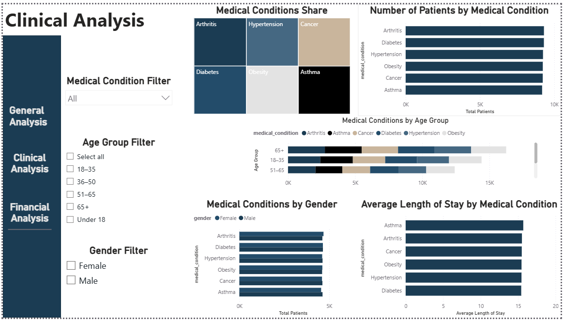
Power BI Dashboard Design
Clinical Analysis

Slide 9
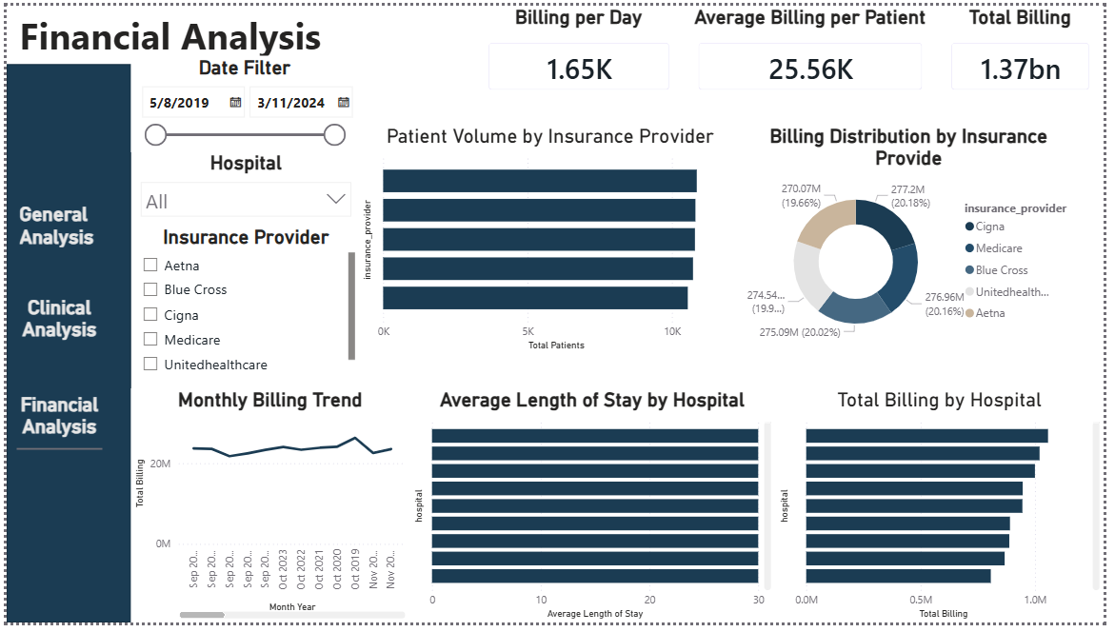
Power BI Dashboard Design
Financial Analysis

Slide 10






Learnings & Insights
Streamlit
SQL
Machine Learning
Learned to use Streamlit for quick interactive web applications
Easy and effective library for displaying medical data
Benefited from SQL for deep insights
Advanced queries helped understand complex relationships between variables
Used models to predict length of stay or cost
High accuracy in predictions based on historical data
Custom Dashboards
Tool Integration
Continuous Improvement
Developed customizable dashboards
Each user can create their own dashboard based on needs
Combined SQL for analysis, Python for preprocessing, Streamlit for display, Power BI for visualizations
Seamless integration of different technologies for healthcare data analysis
Learning from data to improve healthcare quality
Actionable insights for better decision-making in healthcare
Comprehensive Healthcare Dataset Analysis with Interactive Dashboards

Slide 11




Conclusion and Recommendations
Expand Database
Key Insight
Add new variables like quality of life after treatment and readmission rates
Healthcare data is rich with actionable insights
These analyses can be used to improve quality of care and reduce costs
Interactive analysis facilitates timely, informed decision-making
Document Process
Document entire process for other teams to benefit from
Continuous Improvement
Apply predictive models to improve planning and resource allocation

